Slide 1
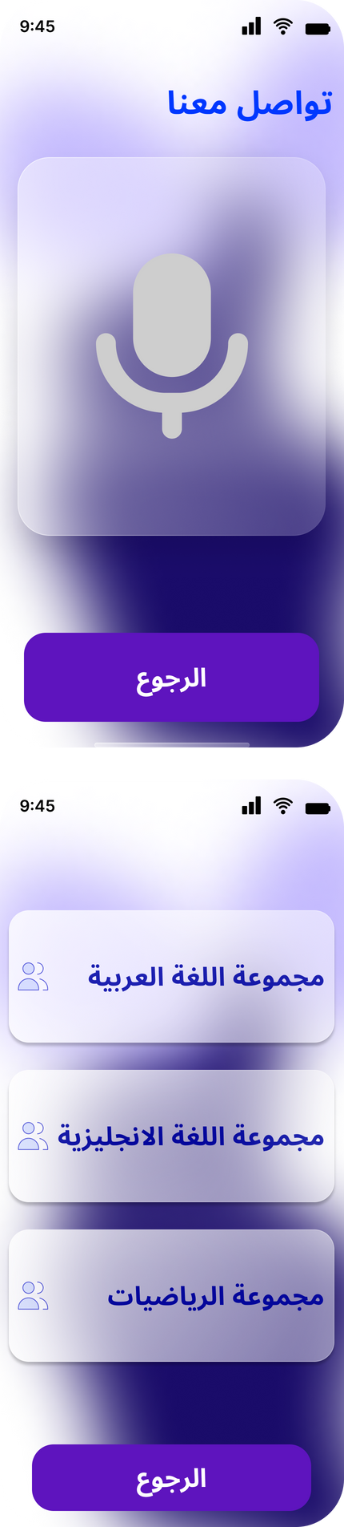
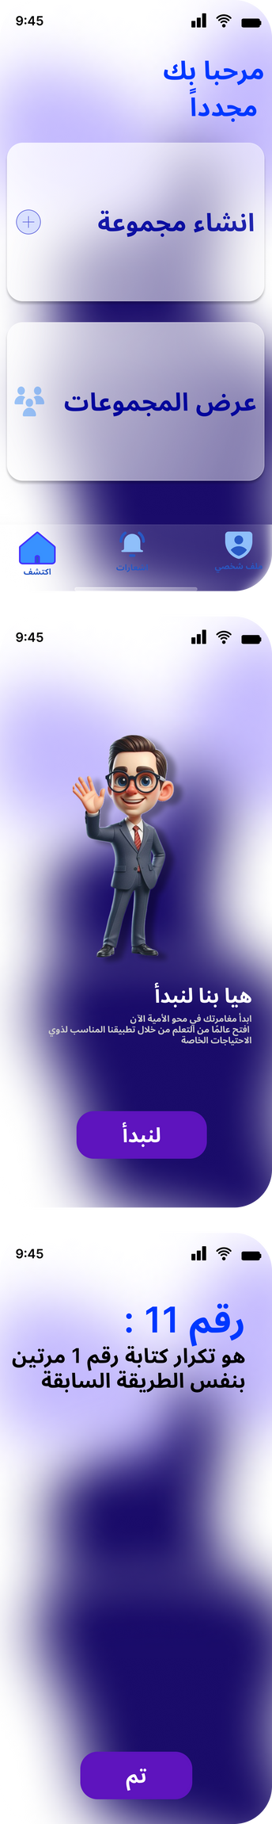



El-Serag
Superviesed By:
Dr. Hussein Elshafie
Dr. Hosny Ahmed
Dr. Ibrahim Elsayed

Slide 2

Mohamed Abelrahman Elkhlawy
Manar Hussien Mohamed
Amina Younis Mohamed
Omar Mohamed Elhassan Madany
Norhan Nageh Elabd
Sara Nabil Mohamed Kamel

Slide 3
Table Of content
1) Problem Formulation
2) Objectives
3) Functional and Non-Functional
4) Design Models
5) Related Work
6) UI
7) Scheduling Phases
8) Challenges and References
9) Conclusion

Slide 4


Problem Formulation
In a world where information is a cornerstone of empowerment and progress, there exists a profound issue that warrants immediate attention. Individuals with special needs, including those with physical disabilities, cognitive impairments, or sensory challenges, often face significant barriers when it comes to accessing and benefiting from traditional literacy education
Existing educational materials and platforms are not always designed to cater to the diverse needs of this population. This lack of inclusivity and accessibility can limit their opportunities for personal growth, communication, and participation in society

Slide 5


Objectives
inclusive Education
Skill Enhancement
ensuring equal access to educational resources.
fostering personal growth and expanding their opportunities for future success
Community Building
Global Reach
support networks to share experiences, best practices, and resources
Extend the reach of the platform to a global audience by incorporating multilingual support
Data-Driven Improvement
Utilize data analytics to track user progress, gather insights, and continuously improve the platform's effectiveness in meeting the evolving needs of individuals with special needs.

Slide 6


Functional Requirements
1.Accessibility
2.User-Friendly Interface
3.Adaptive Learning Materials
4.Progress Tracking
5.Multilingual Support
6.Continuous Improvement
7.User Training Programs

Slide 7

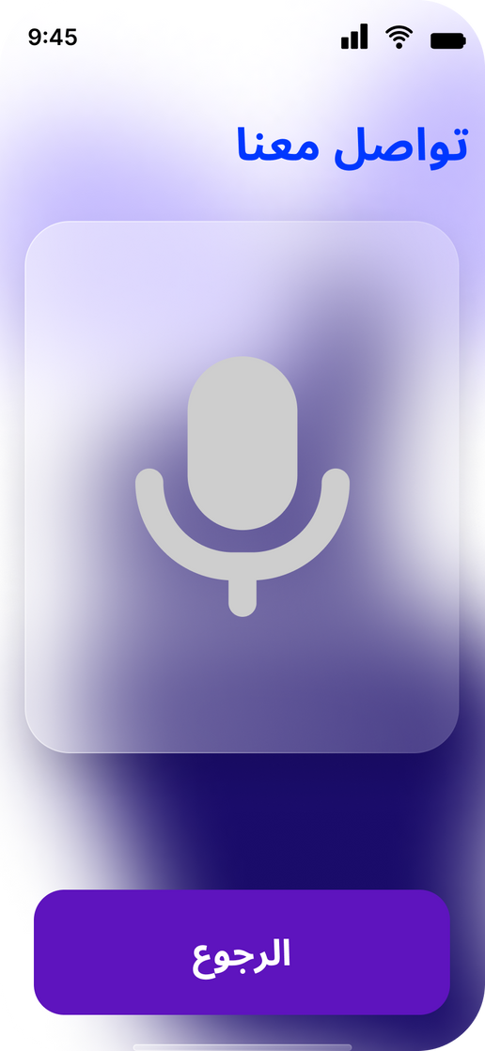

Non-Functional Requirements
1-performance
2-Scalability
3-Reliability
4-Security
5-Data Backup and Recovery
6-Technical Support
7-Legal Compliance

Slide 8

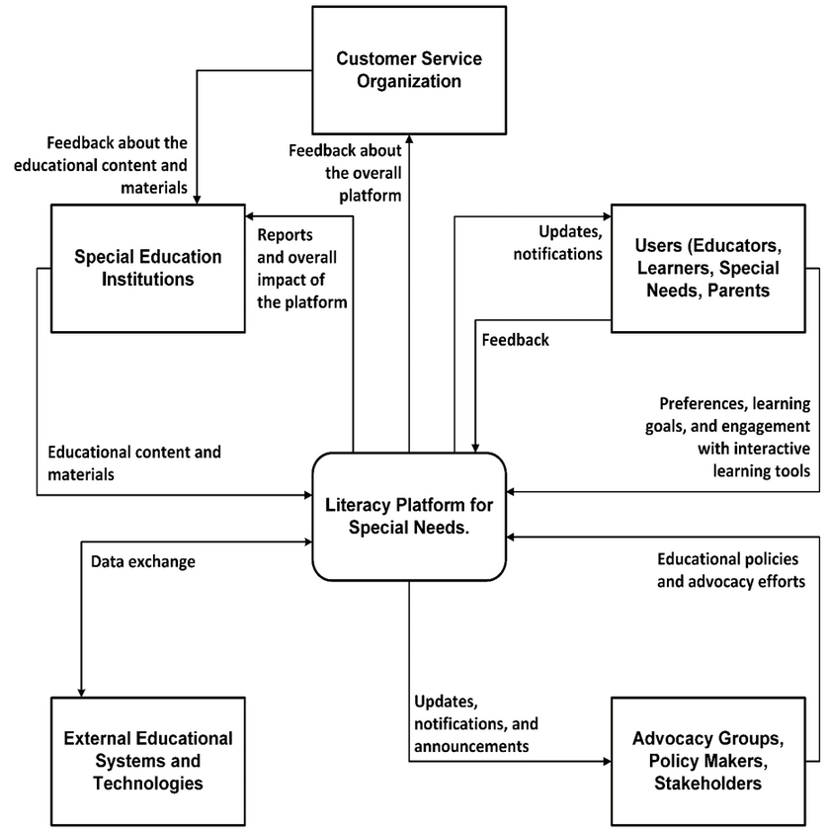


Context Diagram

Slide 9
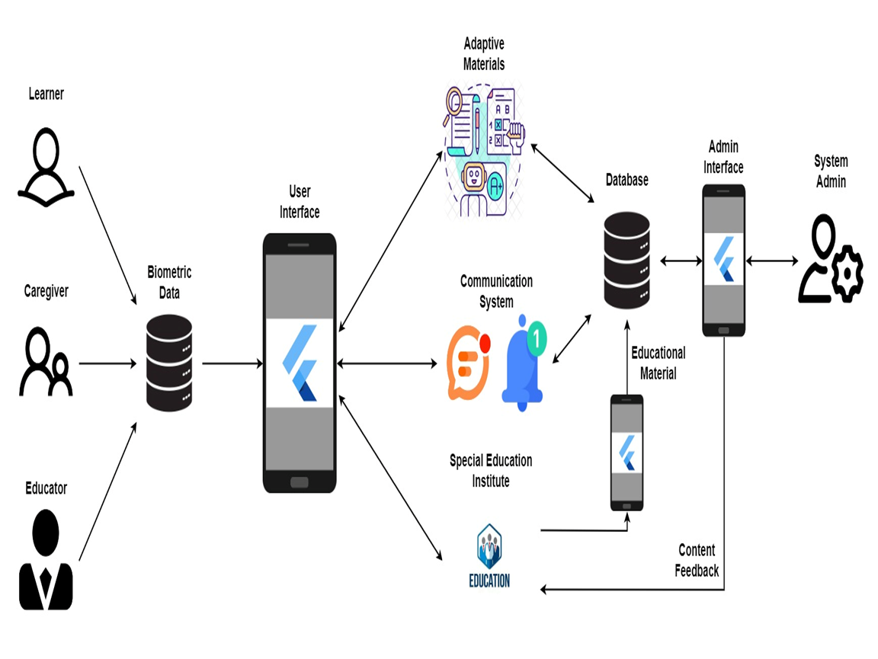
System architecture

Slide 10
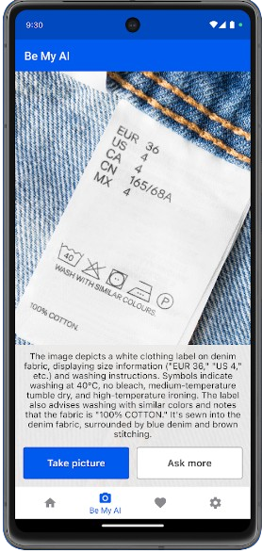
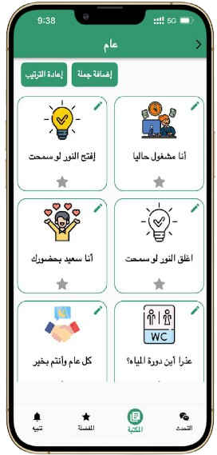
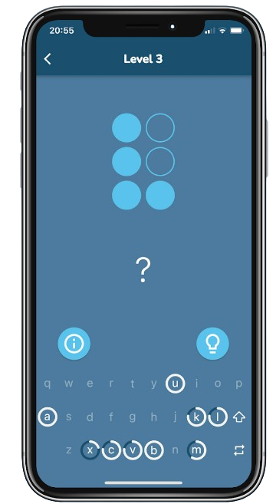
Related Works
Be My eyes
Smart Voice
Braille Academy
Live video assistance
Support various tasks
Adjustable reading speed
Text-to-speech for different document types
Interactive braille lessons
Voice-guided instructions

Slide 11
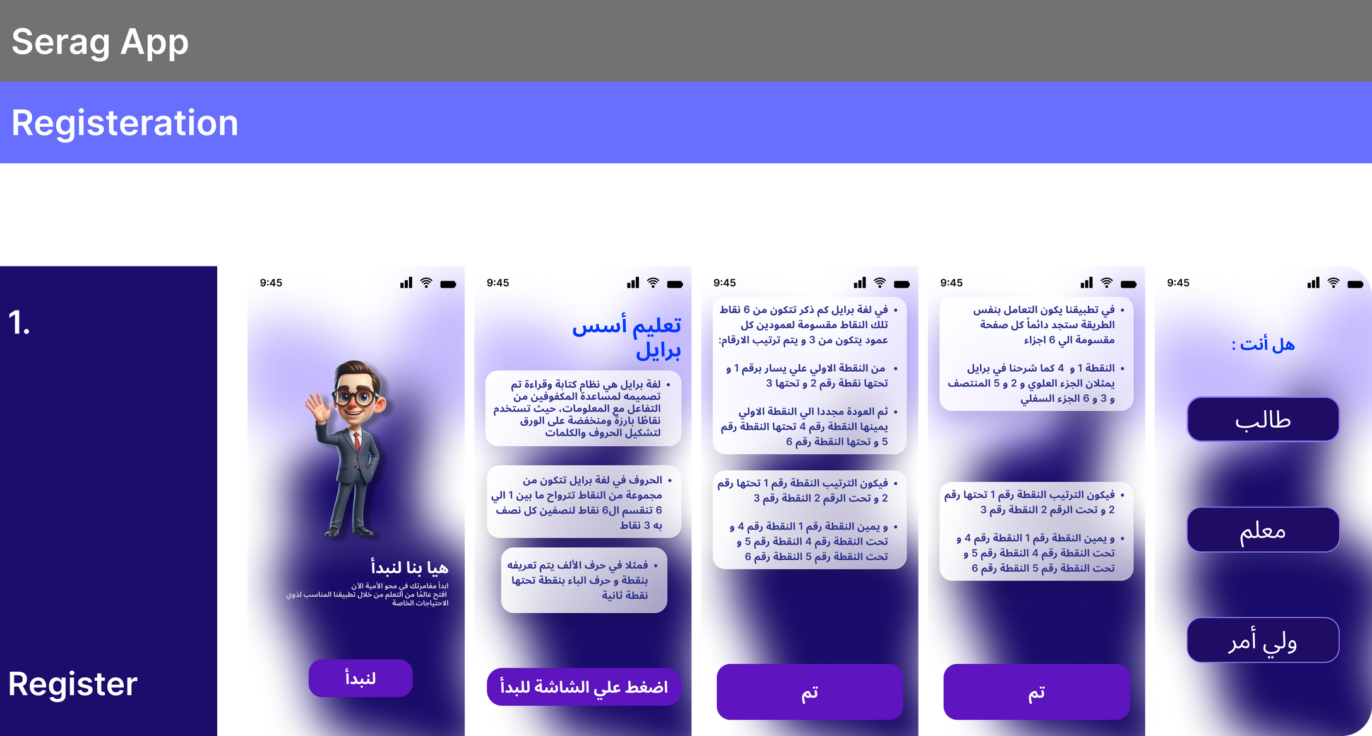
UI Mock Up

Slide 12
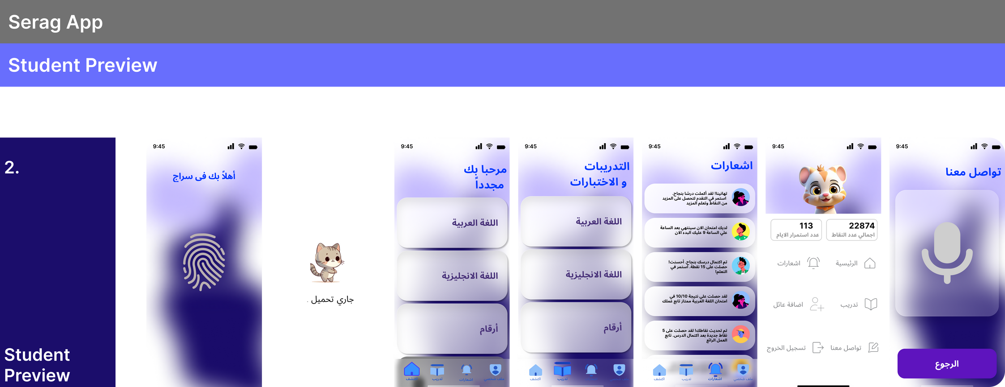
UI Mock Up

Slide 13
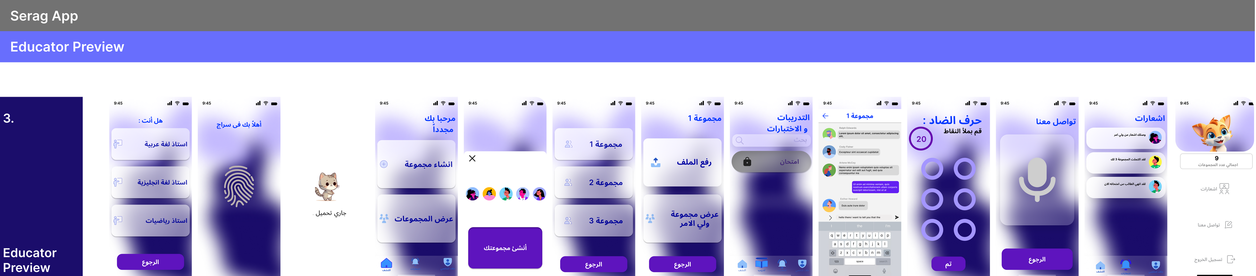
UI Mock Up

Slide 14
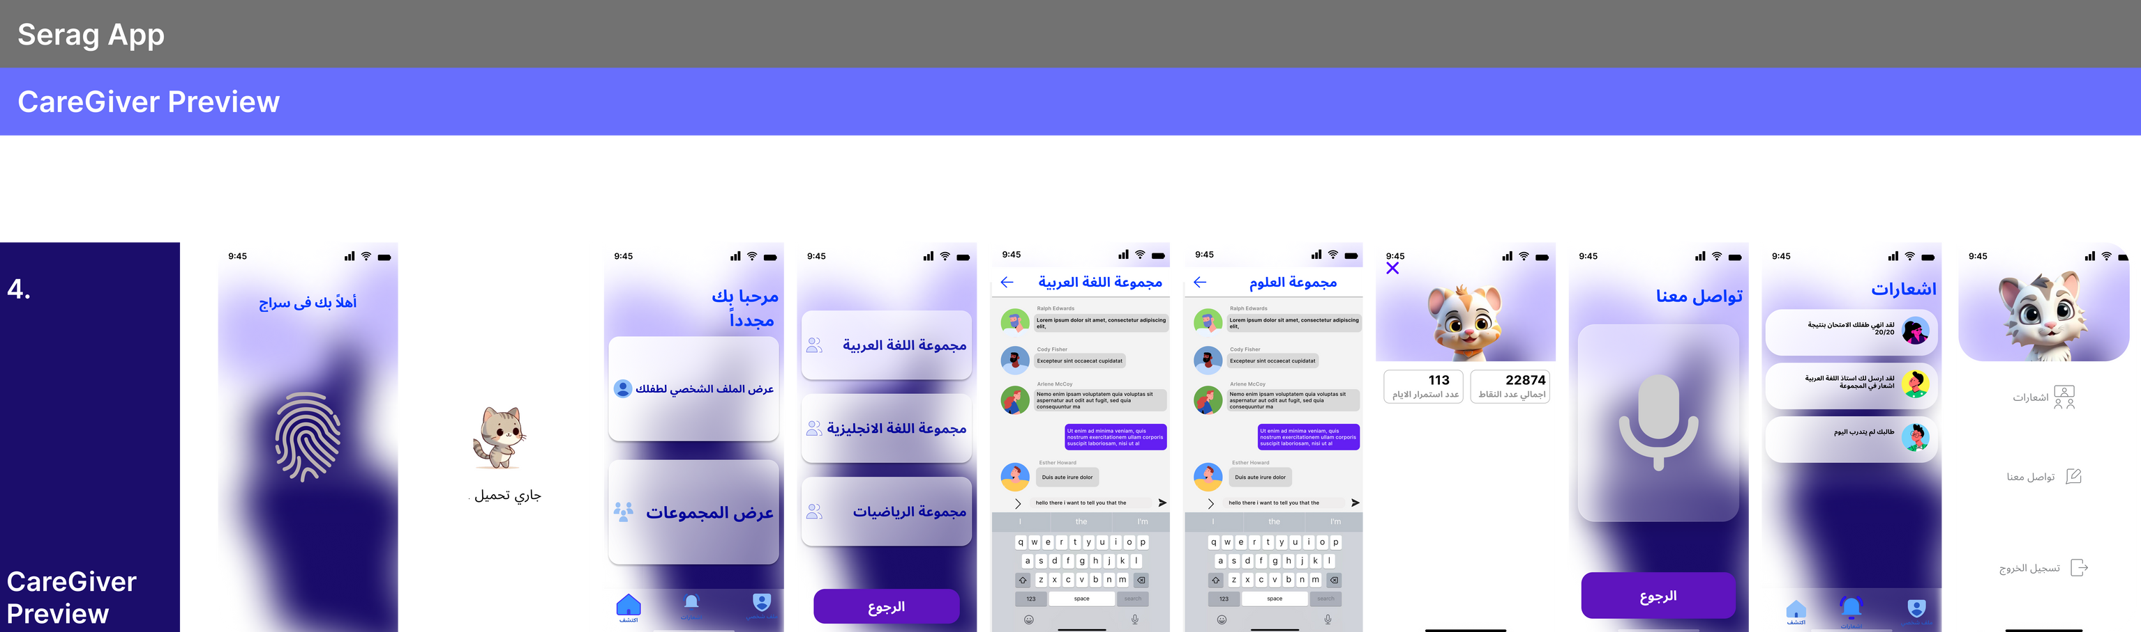
UI Mock Up

Slide 15

Scheduling Phases
Phase | Nov | Dec | Jan | Feb | Mars | April | May | June
Gathering Information
Define Requirements
Analysis
Design
Implementation
Testing and Final Discussion

Slide 16
Challenges & References
Insufficient resources
Elnour School for Blind People
System Insight
Elnour and Elamal School
Dr. Hussien Elshafie
Dr. Mohamed Fouad
External PoV
Mohamed Gamal eldeen
Abdelrahim Alsadiq

Slide 17


Conclusion
The envisioned literacy platform for individuals with special needs represents a transformative and inclusive initiative aimed at overcoming barriers to traditional education. By integrating adaptive learning methodologies, personalized pathways, and robust community support, the project seeks to empower learners, educators, caregivers, and institutions within the special education domain. The commitment to accessibility, inclusivity, and privacy, coupled with innovative features such as interactive tools and multilingual support, positions the platform as a pivotal resource for fostering personalized and enriching educational experiences.

Slide 18


THank you for Listening

